Slide 1
Understanding Deep Learning
and How it Works
Liang Lin
Sun Yat-sen University

Slide 2
Outline
1
The Overview of Deep Learning
2
Why does Deep Learning Work
3
Deep Learning for Visual Understanding
4
The Future of Work

Slide 3
Outline
1
The Overview of Deep Learning
2
Why does Deep Learning Work
3
Deep Learning for Visual Understanding
4
The Future of Work

Slide 4
Outline
1
The Overview of Deep Learning
2
Why does Deep Learning Work
3
Deep Learning for Visual Understanding
4
The Future of Work

Slide 5
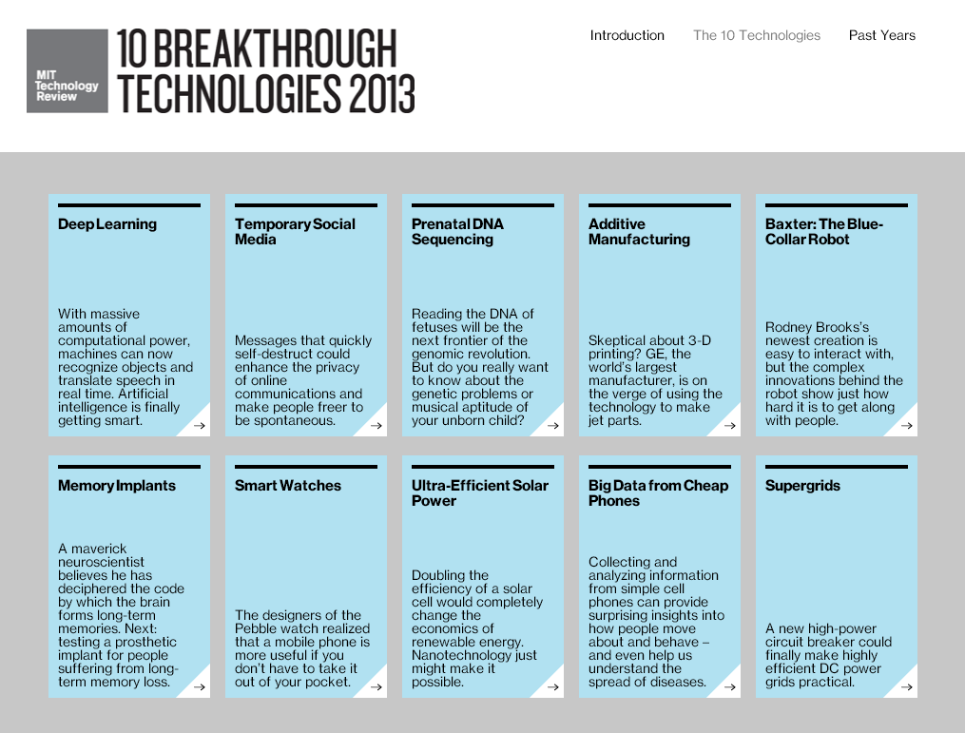

Slide 6
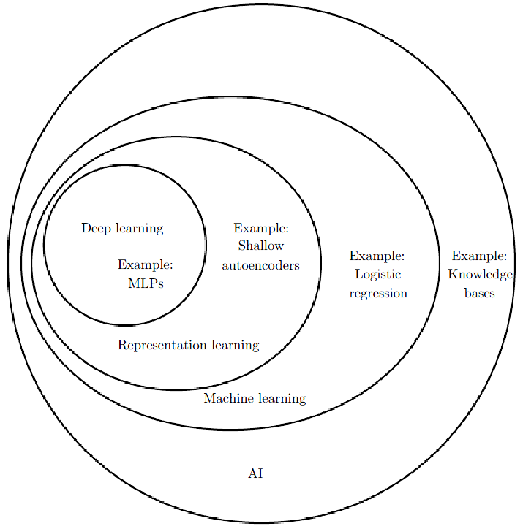
Deep Learning，Machine Learning and AI
Deep Learning is a kind of representation learning, which is in turn a kind of machine learning, which is used for many but not all approaches to Artificial Intelligence.
The figure is copied from Ian Goodfellow, Yoshua Bengio, Aaron Courville, Deep Learning, 2015

Slide 7
Deep Learning，Machine Learning and AI
The different parts of an AI system relate to each other within different AI disciplines
Input
Hand designed program
Output
Rule-based systems
Classic machine learning
Input
Hand designed features
Mapping from features
Output
Representation learning
Input
Features
Mapping from features
Output
Deep learning
Input
Simple features
More abstract features
Mapping from features
Output
The figure refers to Ian Goodfellow, Yoshua Bengio, Aaron Courville, Deep Learning, 2015

Slide 8

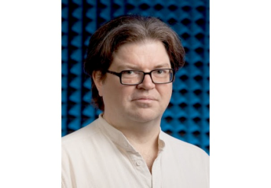
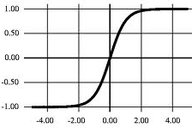
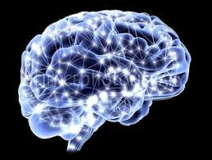
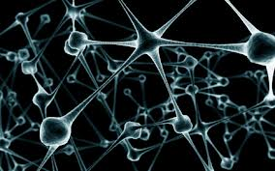
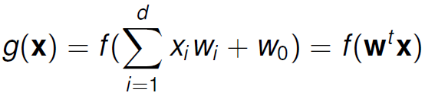
The Overview of Deep Learning
Neural
network
Back
propagation
Nature
1940s
1986
g(x)
w₁
w₂
w₃
x₁
x₂
x₃
f(net)

Slide 9
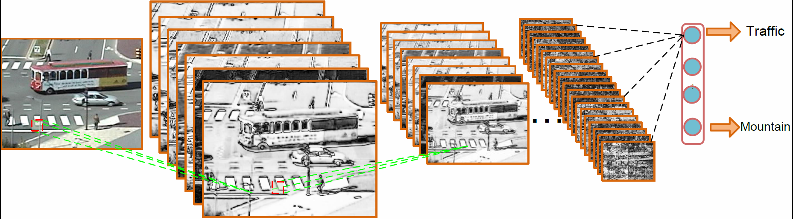
The Overview of Deep Learning
Neural
network
Back
propagation
Convolutional
neural network
1940s
1986
1998

Slide 10
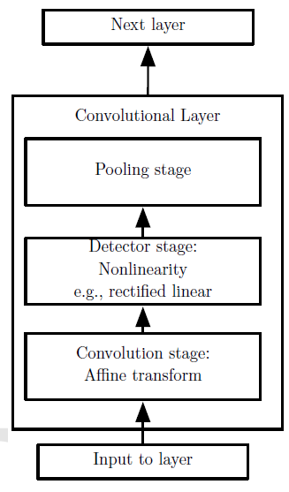
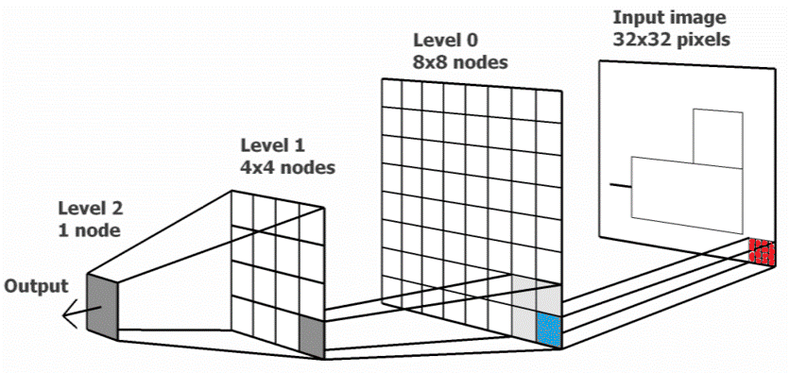
Convolutional Neural Networks
Neurons of a convolutional layer (blue), connected to their receptive field (red).
The figure is copied from Ian Goodfellow, Yoshua Bengio, Aaron Courville, Deep Learning, 2015

Slide 11
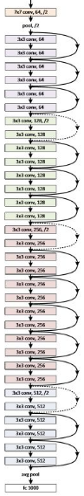
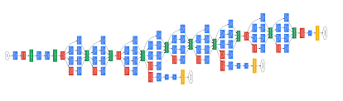
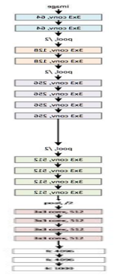
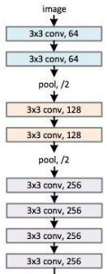
Revolution of Depth
Going Deeper
Skip Connection: Inception , Residual
AlexNet
(8 layers)
VGG
(19 layers)
GoogLeNet
(22 layers)
ResNet
(152 layers)

Slide 12
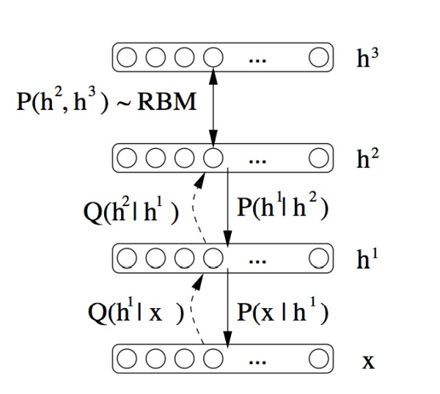
The Overview of Deep Learning
Neural
network
Back
propagation
Convolutional
neural network
Deep
belief net
1940s
1986
1998
2006

Slide 13
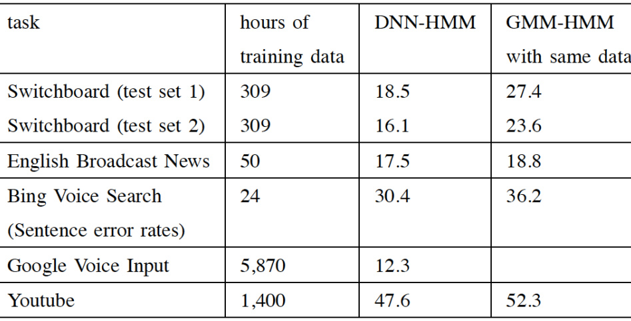

The Overview of Deep Learning
Neural
network
Back
propagation
Convolutional
neural network
Deep
belief net
Speech
1940s
1986
1998
2006
2011
deep learning results
But it is given up…
Deep Learning leads to breakthrough in Speech Recognition at MSR

Slide 14
The Overview of Deep Learning
Neural
network
Back
propagation
Convolutional
neural network
Deep
belief net
Speech
Not well accepted by the vision community
1940s
1986
1998
2006
2011
LeCun’s open letter in CVPR 2012
So, I’m giving up on submitting to computer vision conferences altogether. CV reviewers are just too likely to be clueless or hostile towards our brand of methods. Submitting our papers is just a waste of everyone’s time (and incredibly demoralizing to my lab members)
I might come back in a few years, if at least two things change:
- Enough people in CV become interested in feature learning that the probability of getting a non-clueless and non-hostile reviewer is more than 50% (hopefully [Computer Vision Researcher]‘s tutorial on the topic at CVPR will have some positive effect).
- CV conference proceedings become open access.

Slide 15
The Overview of Deep Learning
Neural
network
Back
propagation
Convolutional
neural network
Deep
belief net
ImageNet
(vision)
Speech
1940s
1986
1998
2006
2011
2012
Rank | Name | Error rate | Description
1 | U. Toronto | 0.15315 | Deep learning
2 | U. Tokyo | 0.26172 | Hand-crafted features and learning models. Bottleneck.
3 | U. Oxford | 0.26979
4 | Xerox/INRIA | 0.27058
Object recognition over 1,000,000 images and 1,000 categories (2 GPU)
Current Best Result < 0.03
A. Krizhevsky, L. Sutskever, and G. E. Hinton, “ImageNet Classification with Deep Convolutional Neural Networks,” NIPS, 2012.

Slide 16
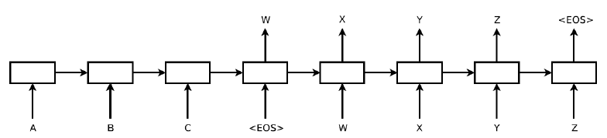
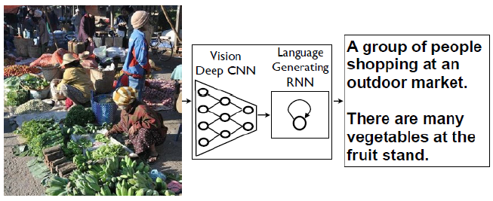
The Overview of Deep Learning
Neural
network
Back
propagation
Convolutional
neural network
Deep
belief net
ImageNet
(vision)
Language
(LSTM)
Speech
1940s
1986
1998
2006
2011
2012
2014
Language translation
Image caption generation
Natural Language Processing
Computer
Vision
Deep Learning

Slide 17
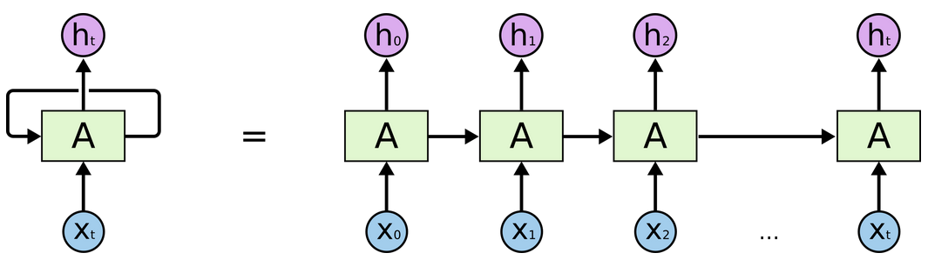
Recurrent Neural Networks
Unrolling recurrent neural networks for back-propagation
RNNs are hard to train with back-propagation
Vanishing gradient problems (Hochreiter 1991; Bengio et al., 1994)
Has trouble learning “long-term dependencies as the depth grows
Understanding LSTM Networks, colah’s blog

Slide 18
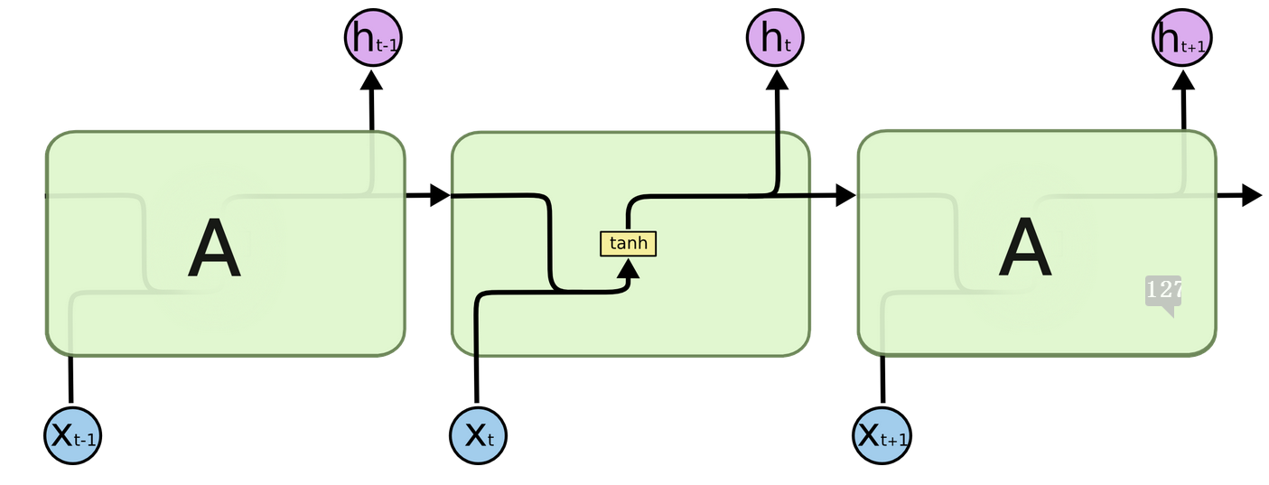
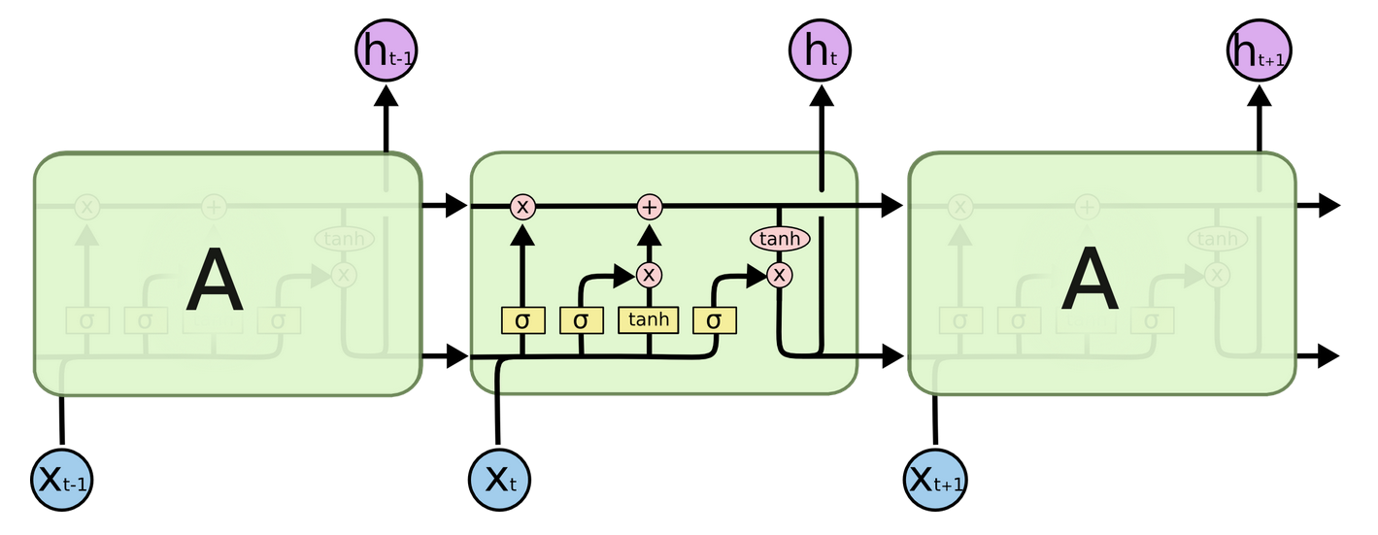
Long Short Term Memory
Standard RNN
Gating Functions
Long Short Term Memory
LSTMs are explicitly designed to avoid the long-term dependency problem.
It uses linear memory cells surrounded by multiplicative gate units to store read, write and reset information
Understanding LSTM Networks, colah’s blog
Notes:
Gating functions to select information for passing and remembering

Slide 19
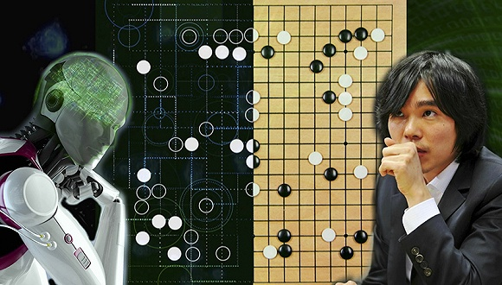
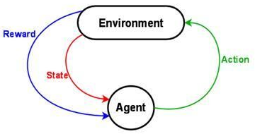
The Overview of Deep Learning
Neural
network
Back
propagation
Convolutional
neural network
Deep
belief net
ImageNet
(vision)
Language
(LSTM)
AlphaGo
(RL)
Speech
1940s
1986
1998
2006
2011
2012
2014
2015
1920 CPU and 280 GPU

Slide 20
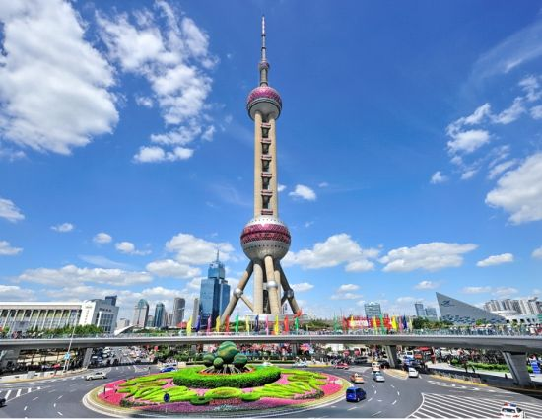
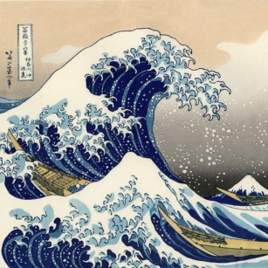
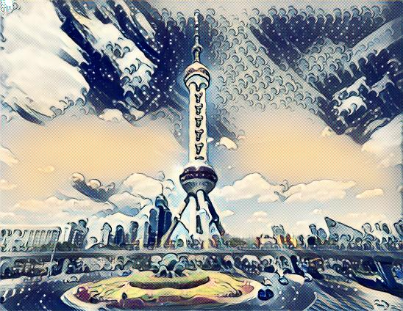
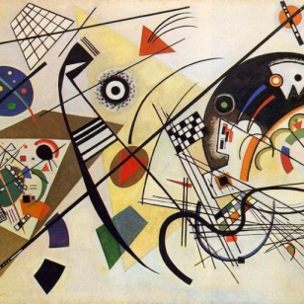
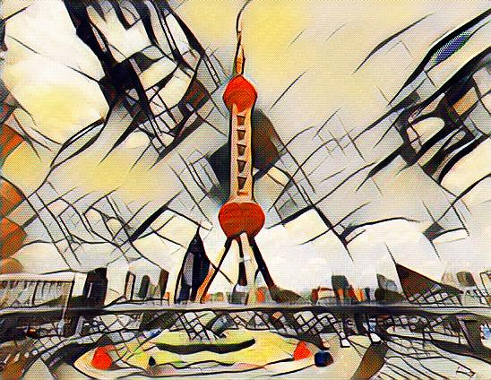
The Overview of Deep Learning
Neural
network
Back
propagation
Convolutional
neural network
Deep
belief net
ImageNet
(vision)
Language
(LSTM)
AlphaGo
(RL)
More models
…
Speech
1940s
1986
1998
2006
2011
2012
2014
2015
2016
Generative Adversarial Network (GAN)

Slide 21
Outline
1
The Overview of Deep Learning
2
Why does Deep Learning Work
3
Deep Learning for Visual Understanding
4
The Future of Work

Slide 22
Why does Deep Learning Work
Domain Knowledge
Structure
Image Level
Relation
Object Level
Layout
Pixel Level
Design Basis and Supervisory information
Rich and Structured Information
Network
Architecture
Large Scale Dataset
AlexNet
ImageNet
GoogleNet
Visual Genome
ResNet
YouTube 8M
Training Samples

Slide 23
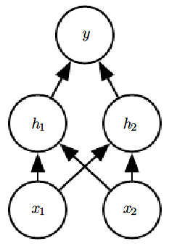
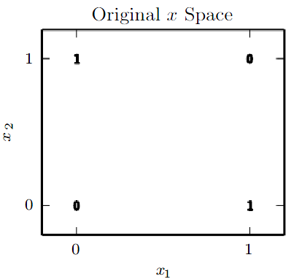
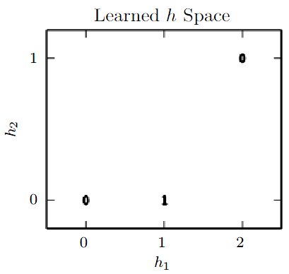
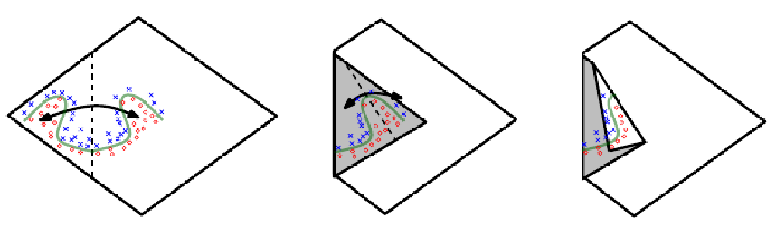
Network Architecture
XOR Problem
An intuitive, geometric explanation of the exponential advantage of deeper networks
The figure is copied from Ian Goodfellow, Yoshua Bengio, Aaron Courville, Deep Learning, 2015

Slide 24
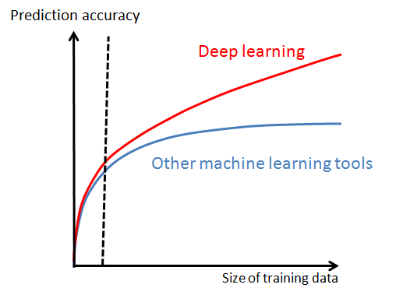
Data vs. Network Architecture
Machine learning with small data：
overfitting, reducing model complexity (capacity), adding regularization
Machine learning with big data：
underfitting, increasing model complexity, optimization, computation resource
AI system
Engine
Deep learning
Fuel
Big data

Slide 25
Data vs. Domain Knowledge
Big data
Rich information
Challenging supervision task
with rich predictions
How to make use of it?
Capacity
Hierarchical
Feature Learning
Capture
Contextual Information
Reduce Capacity
Joint
optimization
Take
large input
Go Wider
Domain
knowledge
Go Deeper
Make Learning more Efficient

Slide 26
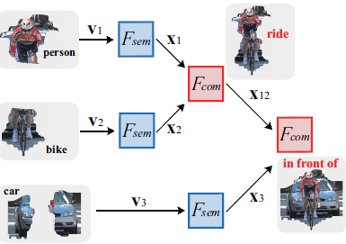
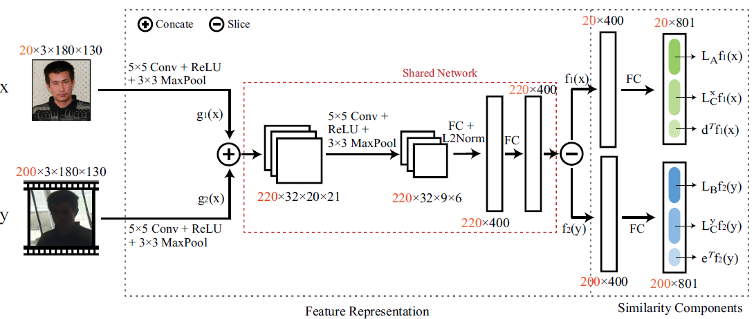
Network Architecture vs. Domain Knowledge
LSTM
RNN
Graph Topology
Graph Topology
Graph LSTM
CNN-RNN
ECCV 2016
CVPR 2016
CNN
Metric Learning
Deep Generalized Similarity
T-PAMI 2016

Slide 27




Community Development
Theano
Caffe
Torch

Slide 28
Outline
1
The Overview of Deep Learning
2
Why does Deep Learning Work
3
Deep Learning for Visual Understanding
4
The Future of Work

Slide 29
Deep Learning for Visual Understanding
Domain Knowledge
Structure
Image Level
Relation
Object Level
Layout
Pixel Level
Design Basis and Supervisory information
Rich and Structured Information
Network
Architecture
Large Scale Dataset
AlexNet
ImageNet
GoogleNet
Visual Genome
ResNet
YouTube 8M
Training Samples

Slide 30
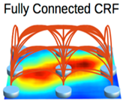
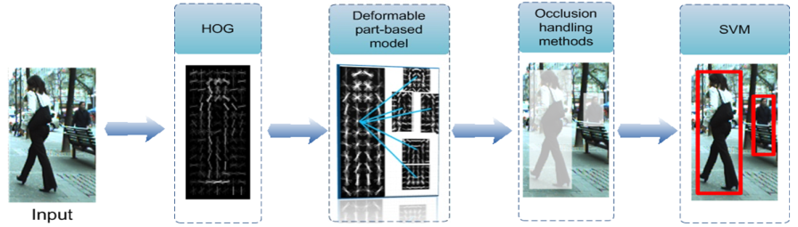
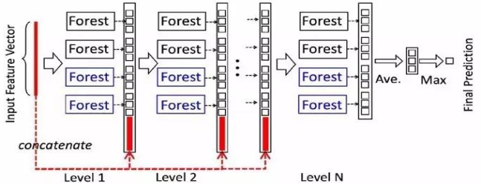
Deep Learning for Visual Understanding
The Art of Network Architecture Design
Combine with Traditional Visual Models
e.g. AOG , DPM, CRF, Decision Trees and so on
Fusion with Context or Prior
e.g. Human Skeleton Information for Pose Estimation
Scene Information for Object Recognition
Super-pixel Information for Scene Labeling
Inspiring by Cognition
e.g. Curriculum Learning , Self-paced Learning,
e.g. Attention Mechanism, Reinforcement Learning
Notes:
Pic1: Deeplab
Pic2：W. Ouyang and X. Wang. A Discriminative Deep Model for Pedestrian Detection with Occlusion Handling. CVPR, 2012.
Pic3: Deep Forest: Towards An Alternative to Deep Neural Networks, Zhi-Hua Zhou, Ji Feng

Slide 31
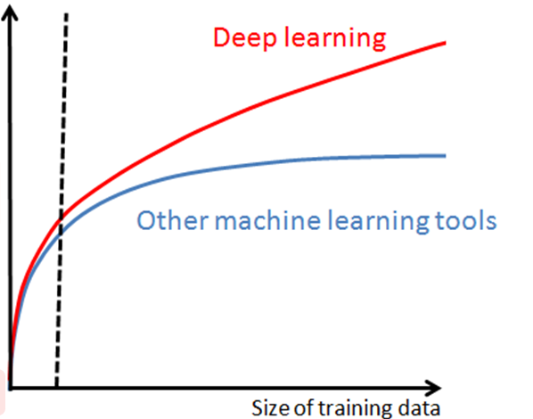
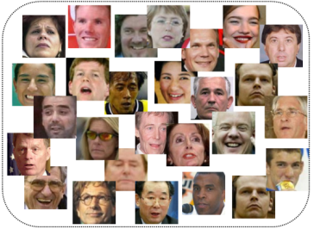
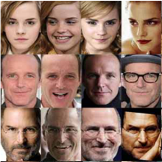
Deep Learning for Visual Understanding
The Power of Abundant Data
Unabeled
Data
Supervised Learning
Semi-supervised Learning
Weak supervised Learning
Labeled
Data
Unsupervised Learning
The Effectiveness of High-level Semantic Knowledge
The Relation between Object
Scene Structured Configuration
Image Descriptions

Slide 32
Deep Learning for Visual Understanding
The Art of Network Architecture Design
Combine with Traditional Visual Models
Two Related Works
Cross-Domain Visual Matching via Generalized Similarity Measure and Feature Learning
A Deep Structured Model with Radius-Margin Bound for 3D Human Activity Recognition

Slide 33
Deep Learning for Visual Understanding
Cross-Domain Visual Matching via Generalized Similarity Measure and Feature Learning

Slide 34
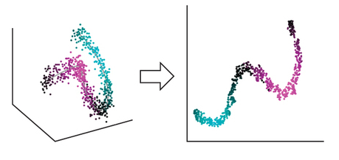
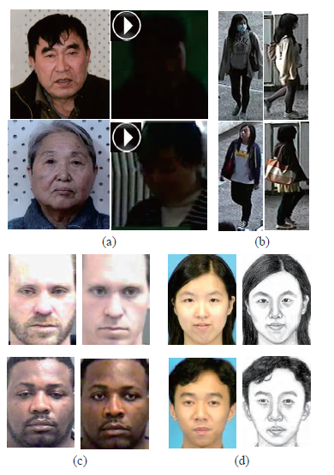
Cross-Domain Visual Matching via Generalized Similarity Measure and Feature Learning
Background：Cross Domain Data

Slide 35
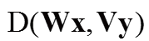
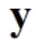


Cross-Domain Visual Matching via Generalized Similarity Measure and Feature Learning
Background：Cross Domain Data
Traditional Similarity Learning and its shortcomings
Euclidean distance OR Inner production are applied.
Shortcomings:
Special space
Fixed feature representation
Simplify (shared) domain-specific projection
Euclidean (Mahalanobis) or Inner Production, which is optional?
W = V

Slide 36
Cross-Domain Visual Matching via Generalized Similarity Measure and Feature Learning
Generalized Similarity Learning
Generalization?
Generalization:
linear transformation → affine transformation
Wx, Vy → Wx + a, Vy + b
Data-driven combination of Mahalanobis distance and cosine distance

Slide 37
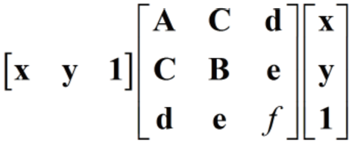
Cross-Domain Visual Matching via Generalized Similarity Measure and Feature Learning
Generalized Similarity Learning
Affine transformation + Combination of Mahalanobis
distance and cosine distance

Slide 38
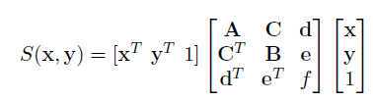
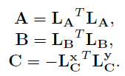
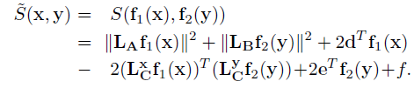
Cross-Domain Visual Matching via Generalized Similarity Measure and Feature Learning
Integrating with Deep CNNs
Assumption: A and B are positive semi-definite
CNN-based feature
Similarity components

Slide 39
Cross-Domain Visual Matching via Generalized Similarity Measure and Feature Learning
Integrating with Deep CNNs
X
f₁(x)
weight matrix L_{A}
X_{A}
X_{C}
weight matrix L^{x}_{C}
X_{d}
weight vector d
Y
f₂(y)
weight matrix L_{B}
Y_{B}
weight matrix L^{y}_{C}
Y_{C}
Y_{d}
weight vector e

Slide 40
Cross-Domain Visual Matching via Generalized Similarity Measure and Feature Learning
Deep Architecture
Domain-specific alignment
Shared feature learning
projection

Slide 41
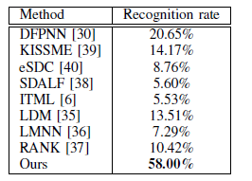
Cross-Domain Visual Matching via Generalized Similarity Measure and Feature Learning
Results
Person re-identification
CVPR 14
CVPR 12
CVPR 13
CVPR 10
ICML 07
ICCV 09
NIPS 05
ICML 10

Slide 42
Deep Learning for Visual Understanding
A Deep Structured Model with Radius-Margin Bound for 3D Human Activity Recognition

Slide 43

A Deep Structured Model with Radius-Margin Bound for 3D Human Activity Recognition
Background
Difficulties of complex human activity recognition
Representing complex human appearance and motion
Avoiding the noise of self-occlusion of the body parts
Activity examples: Each row denotes the same activity in diverse poses/views of individuals.

Slide 44

A Deep Structured Model with Radius-Margin Bound for 3D Human Activity Recognition
Background
Difficulties of complex human activity recognition
Capturing large temporal variations of human activities
Decomposing a human activity into sub-activities/actions
Variant
temporal
lengths
Activity = Temporal compositions of actions
Notes:
Illustration of high- and low-confidence samples in the feature space. (a) shows a few
instances of different object categories, and these instances have large appearance variations. (b)
illustrates how the samples distribute in the feature space, where samples of high classification
confidence distribute compactly to form several clusters and low confidence samples are scattered
and close to the classifier decision boundary.

Slide 45


A Deep Structured Model with Radius-Margin Bound for 3D Human Activity Recognition
Motivation
Deep Architecture
Act directly on grayscale-depth data rather than hand-craft features
Appearance features
Motion features
3D Convolution across temporal and spatial domains among 3 adjacent frames
Notes:
Illustration of high- and low-confidence samples in the feature space. (a) shows a few
instances of different object categories, and these instances have large appearance variations. (b)
illustrates how the samples distribute in the feature space, where samples of high classification
confidence distribute compactly to form several clusters and low confidence samples are scattered
and close to the classifier decision boundary.

Slide 46

A Deep Structured Model with Radius-Margin Bound for 3D Human Activity Recognition
Motivation
Deep model with SVM
Pros: Better generalization performance on small data.
Cons: The margin can be increased by simply expanding the feature space!
Notes:
Illustration of high- and low-confidence samples in the feature space. (a) shows a few
instances of different object categories, and these instances have large appearance variations. (b)
illustrates how the samples distribute in the feature space, where samples of high classification
confidence distribute compactly to form several clusters and low confidence samples are scattered
and close to the classifier decision boundary.

Slide 47

A Deep Structured Model with Radius-Margin Bound for 3D Human Activity Recognition
Motivation
Reconfigurable structure
Handle large temporal variations of activities via latent variables

Slide 48



A Deep Structured Model with Radius-Margin Bound for 3D Human Activity Recognition
Deep Model with Relaxed Radius-margin Bound

Slide 49


A Deep Structured Model with Radius-Margin Bound for 3D Human Activity Recognition
Deep Model with Relaxed Radius-margin Bound
Incorporating the latent variables to manipulate the activation of neurons

Slide 50

A Deep Structured Model with Radius-Margin Bound for 3D Human Activity Recognition
Joint Component Learning

Slide 51




A Deep Structured Model with Radius-Margin Bound for 3D Human Activity Recognition
Results

Slide 52
Deep Learning for Visual Understanding
The Art of Network Architecture Design
Fusion with Context or Prior
Two Related Works
Human Parsing with Contextualized Convolutional Neural Network
Progressively Diffused Networks

Slide 53
Deep Learning for Visual Understanding
Human Parsing with Contextualized Convolutional Neural Network

Slide 54

Human Parsing with Contextualized Convolutional Neural Network
Background
Decompose a Human Photo into Semantic Fashion/Body Items
Pixel-level Semantic Labeling

Slide 55
Human Parsing with Contextualized Convolutional Neural Network
Motivation
integrate a variety of context information into a unified network model for the parameters optimization
Cross-layer Context
multi-level feature fusion
Global Image-level Context
coherence between pixel-wise labelling and image label prediction
Local Super-pixel Context
within-superpixel consistency and cross-superpixel appearance consistency
Semantic Edge Context
integrate the semantic edge into the Co-CNN
Notes:
Cross-layer context:
multi-level feature fusion✓
Global image-level context::
coherence between pixel-wise labelling and image label prediction✓
Local Super-pixel context::
within-superpixel consistency and cross-superpixel appearance consistency
Semantic Edge Context
integrate the semantic edge into the Co-CNN

Slide 56





Human Parsing with Contextualized Convolutional Neural Network
Cross-layer Context
Four feature map fusions
5*5 convolutions
Hierarchically combine the low-level local details and high-level semantic information

Slide 57

Human Parsing with Contextualized Convolutional Neural Network
Global Image-level Context
Incorporate global image label prediction

Slide 58

Human Parsing with Contextualized Convolutional Neural Network
Local Super-pixel Context
Integrate within-super-pixel smoothing and cross-super-pixel neighbourhood voting

Slide 59

Human Parsing with Contextualized Convolutional Neural Network
Semantic Edge Context
Integrate the semantic edge into the Co-CNN

Slide 60

Human Parsing with Contextualized Convolutional Neural Network
Results
Comparative Methods
Cross-layer
Context
Global Image-level Context
Local Super-pixel Context
Semantic Edge Context

Slide 61
Deep Learning for Visual Understanding
Progressively Diffused Networks

Slide 62

Progressively Diffused Networks
Background : Scene Labelling
Labeling every pixel in the image with the category of the object it belongs to
Labeling these regions requires fully exploiting image cues from different aspects

Slide 63

Progressively Diffused Networks
Motivation: Diffused Mechanism
Using the information from different neighbors to enrich the feature representation of one certain site
Propagating different information from the certain site to its different neighbors to guide their further representation
Previous Works
Our Novel Work

Slide 64

Progressively Diffused Networks
Diffused Layer
Contextual feature maps with different meanings

Slide 65



Progressively Diffused Networks
Diffused Layer
Convolutional Operations in Diffused Layer
Different Context Information

Slide 66

Progressively Diffused Networks
Architecture
Several diffusion layers is stacked on the top of CNN for context modeling
The depth feature maps are convolved with 11 convolutional filters to generate score maps
All of the score maps from distinct diffusion layers will be merged to predict the final result

Slide 67


Progressively Diffused Networks
Results
CVPR’15
ICLR’15
Arxiv’15
CVPR’16
Arxiv’16
Input
GT
Ours
ResNet
Input
GT
Ours
ResNet
Visualization of segmentation results on ImageNet Parsing dataset

Slide 68
Deep Learning for Visual Understanding
The Art of Network Architecture Design
Inspiring by Cognition
Two Related Works
Multi-label Image Recognition by Recurrently Discovering Attentional Regions
Attention-Aware Face Hallucination via Deep Reinforcement Learning

Slide 69
Deep Learning for Visual Understanding
Multi-label Image Recognition by Recurrently Discovering Attentional Regions

Slide 70

Multi-label Image Recognition by Recurrently Discovering Attentional Regions
Background
Single-label Image Annotation
Multi-label Image Annotation

Slide 71

Multi-label Image Recognition by Recurrently Discovering Attentional Regions
Background
Razavian et al. CVPR 2014.
Off-the-shelf global features and multi-classifiers
Global features extracted using CNN pre-trained with ImageNet single label data
Multi-SVM
Hypotheses-CNN-Pooling
Notes:
Razavian et al. CVPR 2014.
Use global features to multi-class recognition
Hypotheses-CNN-Pooling.
proposal: bing / edgebox
For each proposal: classification

Slide 72
Multi-label Image Recognition by Recurrently Discovering Attentional Regions
Background
Shortcoming of Current Methods:
Global Features Base Methods
Image-level features are not optimal for multi-label images recognition.
Image-level features tends to ignore the small objects.
Proposal Features Base Methods
Extract discriminative regions and train the classification network separately
Thousands of proposal, time consuming.
End-to-end framework for simultaneously discriminative region location and multi-object classification
Notes:
Razavian et al. CVPR 2014.
Use global features to multi-class recognition
Hypotheses-CNN-Pooling.
proposal: bing / edgebox
For each proposal: classification

Slide 73

Multi-label Image Recognition by Recurrently Discovering Attentional Regions
Framework
Two Iteratively Steps:
Locate discriminative region base attention mechanism
Recognize the category of the current region

Slide 74


Multi-label Image Recognition by Recurrently Discovering Attentional Regions
Results
Results on MS-COCO
Results on PASCAL VOC2007

Slide 75
Deep Learning for Visual Understanding
Attention-Aware Face Hallucination via Deep Reinforcement Learning

Slide 76


Attention-Aware Face Hallucination via Deep Reinforcement Learning
Motivation
The face structure priors and spatial configurations are crucial for face fallucination.
directly recover facial local parts
recover with contextual information

Slide 77








Attention-Aware Face Hallucination via Deep Reinforcement Learning
Attention-FH
States
….
….
Policy Network
Policy Network
Policy Network
Policy Network
Policy Network
Local Enhancement Network
Local Enhancement Network
Local Enhancement Network
Local Enhancement Network
Local Enhancement Network
$$I_{hr}$$
Attended part enhancement
….
….
$$t_{1}$$
$$t_{2}$$
$$t_{i}$$
$$t_{i}+1$$
$$T$$
Recurrently attending and enhancing one patch at each step.
Enhance the patch with the knowledge of past enhanced result.
Find an optimal accommodated enhancement route for each face.

Slide 78
Attention-Aware Face Hallucination via Deep Reinforcement Learning
Attention-FH
Model trained by reinforcement learning technique.
State
Enhanced face results and LSTM hidden vector which encodes action history.
Action
Select the location of patch to be enhanced at current step.
Reward
PSNR between the final output and the ground-truth.

Slide 79



Attention-Aware Face Hallucination via Deep Reinforcement Learning
Attention-FH
Back-Propagation
Policy Network
Local Enhancement Network
Policy Gradient
Convolutions
FC-256
LSTM-512
FC-256
FC-256
FC
FC
Train Policy Network with REINFORCE.
Directly maximize the reward R – the PSNR between final output and groundtruth
Obtain gradients w.r.t policy using REINFORCE:
$$dR/dP=\left\{\begin{aligned}1/P\left(loc | state\right), loc is sampled \\ &0, otherwise\end{aligned}\right.$$

Slide 80


















Attention-Aware Face Hallucination via Deep Reinforcement Learning
Results
Experiment Results on LFW and BioID
CVPR2013
AAAI2015
PR2010
ECCV2014
CVPR2016
arXiv2016
Bicubic BCCNN SRCNN
Bicubic BCCNN SRCNN
Bicubic BCCNN SRCNN
VDSR GLN Our
VDSR GLN Our
VDSR GLN Our

Slide 81






































































































Attention-Aware Face Hallucination via Deep Reinforcement Learning
Example of Attended Regions

Slide 82
Deep Learning for Visual Understanding
The Power of Abundant Data
Two Related Works
Active Self-Paced Learning for Cost-Effective
and Progressive Face Identification
Learning Object Interactions and
Descriptions for Semantic Image Segmentation

Slide 83
Deep Learning for Visual Understanding
Active Self-Paced Learning for Cost-Effective and Progressive Face Identification

Slide 84

Active Self-Paced Learning for Cost-Effective
and Progressive Face Identification
Motivation
Sample Mining
How the sample distribute in the feature space
High- and low-confidence samples
Notes:
Illustration of high- and low-confidence samples in the feature space. (a) shows a few
instances of different object categories, and these instances have large appearance variations. (b)
illustrates how the samples distribute in the feature space, where samples of high classification
confidence distribute compactly to form several clusters and low confidence samples are scattered
and close to the classifier decision boundary.

Slide 85
Active Self-Paced Learning for Cost-Effective
and Progressive Face Identification
Motivation
Cost Effective
For high-confidence samples -- pseudo-labeling in such a self-paced manner.
For low-confidence samples-- active user annotating.
More Robust
Suppress Incorrectly annotated samples due to the compactness/consistency of majority high-confidence samples.

Slide 86

Active Self-Paced Learning for Cost-Effective
and Progressive Face Identification
Framework: Cost-Effective & More-Robust
High-confidence sample labeling by Pseudo-labeling
Low-confidence sample annotating by active user annotating

Slide 87

Active Self-Paced Learning for Cost-Effective
and Progressive Face Identification
Model Formulation
To
Adaptively handle both manually annotated and pseudo-labeled samples;
Progressively fit the consistently growing unlabeled data;
Our model is defined as follows:
Incorporating sample weight V into optimizing.

Slide 88


Active Self-Paced Learning for Cost-Effective
and Progressive Face Identification
Results
Cross-Age Celebrity Dataset
CASIA-WebFace-Sub Dataset

Slide 89
Deep Learning for Visual Understanding
Learning Object Interactions
and Descriptions for Semantic Image Segmentation

Slide 90

Learning Object Interactions and Descriptions
for Semantic Image Segmentation
Background
Weak Supervision vs. Per-pixel Annotation
unimportant details
missing important details
e.g. number of people and sheep
grammatical errors
Notes:
(a) visualizes an image in IDW and its raw description, searched by using ‘sheep’ and ‘human’ as keywords. We observe that the description contains unimportant details for object
segmentation (e.g. ‘long blonde hair wearing hat happy time’), missing important details (e.g. number of people and sheep), and grammatical errors. As a side-by-side comparison, (b) shows an
image and its per-pixel annotation of VOC12.

Slide 91

Learning Object Interactions and Descriptions
for Semantic Image Segmentation
Background
Semi- and Weakly-supervised Image Segmentation
Lin L, Wang G, Zhang R, et al. Deep structured scene parsing by learning with image descriptions[c]. CVPR 2016: 2276-2284.

Slide 92
Learning Object Interactions and Descriptions
for Semantic Image Segmentation
Motivation
Attempt to show that image descriptions in the wild are able to improve image segmentation.
Knowledge from both strong and weak annotation are fully explored and transferred from each other to boost the performances of both segmentation and object interaction prediction.
Constantly improve segmentation accuracy by appending more weak-annotated data, showing its scalability and potential in large-scale applications

Slide 93

Learning Object Interactions and Descriptions
for Semantic Image Segmentation
Data Collection
IDW has 41,421 images and descriptions.
Image number of each object category shown in (a).
Each image has 1.5 interactions on average, shown in (b).
For evaluation, we create three test sets.
int-IDW: a test set of object interaction prediction, 1440 images.
seg-IDW: segmentation test set, shown in (c), 1440 images.
zero-IDW: a zero-shot test of unseen object interactions, e.g. ‘person ride cow’, 1000 images.

Slide 94

Learning Object Interactions and Descriptions
for Semantic Image Segmentation
Image Description Representation

Slide 95



Learning Object Interactions and Descriptions
for Semantic Image Segmentation
Network Overview
The first stream: predicts image segmentation labelmap
The second stream:
21 object subnets recognize object classes appeared in the object interactions
22 action subnets predict action items between them

Slide 96




Learning Object Interactions and Descriptions
for Semantic Image Segmentation
Int-stream
Output:
Object prediction
Output:
Interaction prediction
Input:
Segmentations
Input:
Features
features
person’s segmentation = person’s features
features
bike’s segmentation = bike’s features
96

Slide 97



Learning Object Interactions and Descriptions
for Semantic Image Segmentation
Object Subnets & Action Subnets
97

Slide 98


Learning Object Interactions and Descriptions
for Semantic Image Segmentation
Results
VOC 2012 Test Set
↑ 6.1
seg-IDW
↑ 8.5
98

Slide 99
Deep Learning for Visual Understanding
The Effectiveness of High-level Semantic Knowledge
Two Related Works
Deep Structured Scene Parsing
by Learning with Image Descriptions
Knowledge-Guided Recurrent Neural Network Learning for Task-oriented Action Prediction

Slide 100
Deep Learning for Visual Understanding
Deep Structured Scene Parsing by Learning with Image Descriptions

Slide 101

Deep Structured Scene Parsing by Learning
with Image Descriptions
Background : Complicated Scene Parsing
Object Recognition and Localization
Object Relationship
Scene Structured Configuration

Slide 102


Deep Structured Scene Parsing by Learning
with Image Descriptions
Background : Complicated Scene Parsing
Scene Structured
Ambiguity of Scene Structure
multiple structured expressions of a scene
no unified evaluation criteria for Scene Structure

Slide 103

Deep Structured Scene Parsing by Learning
with Image Descriptions
Motivation
Image Descriptions: Rich Content Information
Scene Object Information
Scene Object Information
Scene Structure Information

Slide 104


Deep Structured Scene Parsing by Learning
with Image Descriptions
Framework
CNN
RNN
Person
Car
Person
Ride
Bike
Background
Bike
In Front Of
Car
multi-scale feature
CNN
Object Category
Object Location
RNN
Object Relationship
Scene Structured Configuration
Input

Slide 105

Deep Structured Scene Parsing by Learning
with Image Descriptions
RNN Basic Architecture

Slide 106

Deep Structured Scene Parsing by Learning
with Image Descriptions
Image Descriptions Preprocessing
Constructing Syntax Tree
Irrelevant Vocabulary
Adjectives, Adverbs, etc
Object Name
Multi-names
Irrelevant Object
Useless Relationship
Undefined Relationship
Syntax Tree

Slide 107









Deep Structured Scene Parsing by Learning
with Image Descriptions
Training
Semantic Label Loss
inference
CNN
Sum
RNN
Scene Structure Loss

Slide 108


Deep Structured Scene Parsing by Learning
with Image Descriptions
Results

Slide 109
Deep Learning for Visual Understanding
Knowledge-Guided Recurrent Neural Network Learning for
Task-oriented Action Prediction

Slide 110



Task-Oriented Action Prediction
Background
There exists large semantic gap between image and action
sequence of daily tasks.
Predicting action sequences from image requires large
amounts of data for covering semantic space.
Solution 1
Solution 2

Slide 111

Task-Oriented Action Prediction
Motivation
Fill the semantic gap by introducing a knowledge representation, i.e., the temporal And-Or graph.
Learn the knowledge representation on a small number of labeled data and utilize it to automatically generate more training samples from unlabeled data.

Slide 112



Task-Oriented Action Prediction
Framework
Learning AOG knowledge representation
Automatically generate more training samples.
Training a LSTM model for action prediction.

Slide 113


Task-Oriented Action Prediction
Results
Table 1: the accuracy of the primitive action and object.
Table 2: the accuracy of the completing sequence.

Slide 114

Task-Oriented Action Prediction

Slide 115
Outline
1
The Overview of Deep Learning
2
Why does Deep Learning Work
3
Deep Learning for Visual Understanding
4
The Future of Work

Slide 116
The Shortcoming of DL（Technology）
Abundant data
is desired
Model is inflexible
Training is expensive
Data desired model
The more complex
the problem the more
data for desired
Poor transformation capacity
Don’t know "split - combination - recreation”
Expensive data annotation
Huge hardware investment
poor performance on the Cognitive, reasoning and
small sample learning tasks

Slide 117
The Shortcoming of DL（ Application ）
Great Performance
Poor
Performance
Perceived Task
Cognitive Task
Object Recognition
Object Function Recognition
the game of Go
and Chess
Invented calculus
Experience
Creation

Slide 118



The Future of Work
Depth learning + probabilistic model
Can automatically summarize the high level abstract information in training data
Combination learning of the Concept

Slide 119

The Future of Work
More large-scale data processing
Multi-GPU /CPU /Processing, parallelization of embedded devices
Distributed Computing

Slide 120


The Future of Work
Semi-supervised, unsupervised learning
No longer rely too much on supervisory information
Reduce the cost of data annotations
Automatically learn human face or cat face from data
Hypothesis learning
with the data flow

Slide 121


The Future of Work
Multimodal data learning
Joint learning of multimodal data
Modeling the association between modalities
Cross-modal question - and - answer system
Multimodal knowledge map

Slide 122
Thanks!
Q & A

